Slide 1
MIMIC-III: A free publicly available EHR Database for Research
Earl F Glynn
Data Scientist Research Informatics
KU Med Frontier’s Informatics Meetup 2019-09-26 https://github.com/EarlGlynn/MIMIC-III-Exploration

Slide 2
Outline
What is MIMIC-III?
MIMIC-III: Research and Education
Getting Started with MIMIC-III
MIMIC-III Explorations
Machine Learning Using MIMIC-III
Other PhysioNet Resources
Take Home

Slide 3
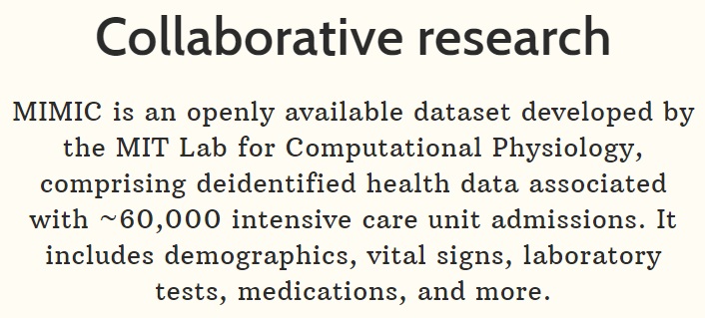

What is MIMIC-III?
https://physionet.org/content/mimiciii/1.4/
https://mimic.physionet.org/ https://github.com/MIT-LCP/mimic-code
PhysioNet is a repository of freely-available medical research data, managed by the MIT Laboratory for Computational Physiology
MIMIC = Medical Information Mart for Intensive Care

Slide 4
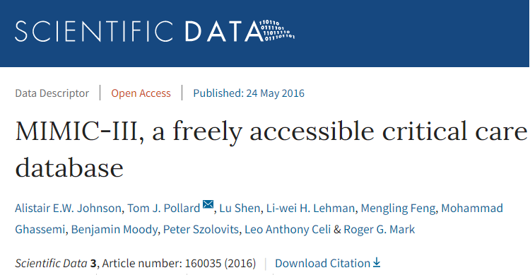
What is MIMIC-III?
https://www.nature.com/articles/sdata201635
“MIMIC-III integrates deidentified, comprehensive clinical data of patients
admitted to the Beth Israel Deaconess Medical Center in Boston, Massachusetts, and makes it widely accessible to researchers Internationally under a data use agreement.”

Slide 5
MIMIC-III: Research and Education
MIMIC-III supports applications including academic and industrial research, quality improvement initiatives, and higher education coursework.
MIMIC-III is great data source for data science experiments, including predictive analytics.

Slide 6
Getting Started with MIMIC-III
Training Requirements
Online Resources
Loading Postgres Database
Querying MIMIC-III
https://github.com/EarlGlynn/MIMIC-III-Getting-Started

Slide 7
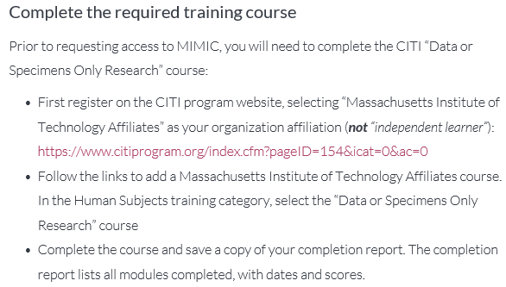

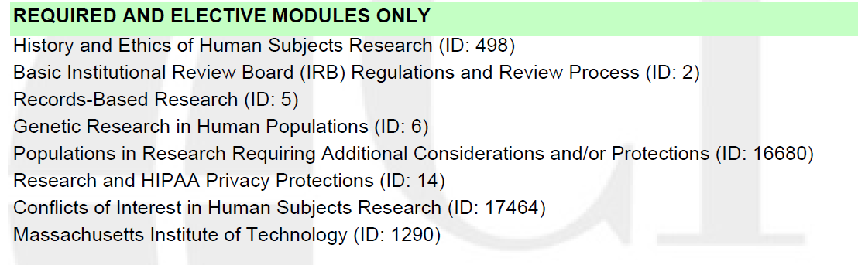
Getting Started with MIMIC-III Training Requirements
https://mimic.physionet.org/gettingstarted/access/

Slide 8
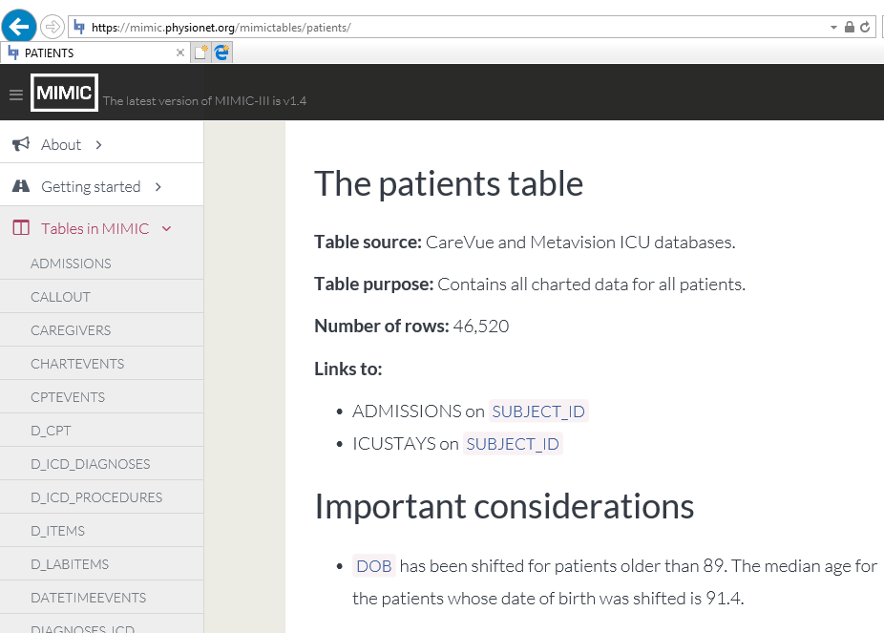
Getting Started with MIMIC-III Online Resource: Data Dictionary
Date-of-Birth ranges from 1800 to 2201!
https://mimic.physionet.org/mimictables/patients/

Slide 9
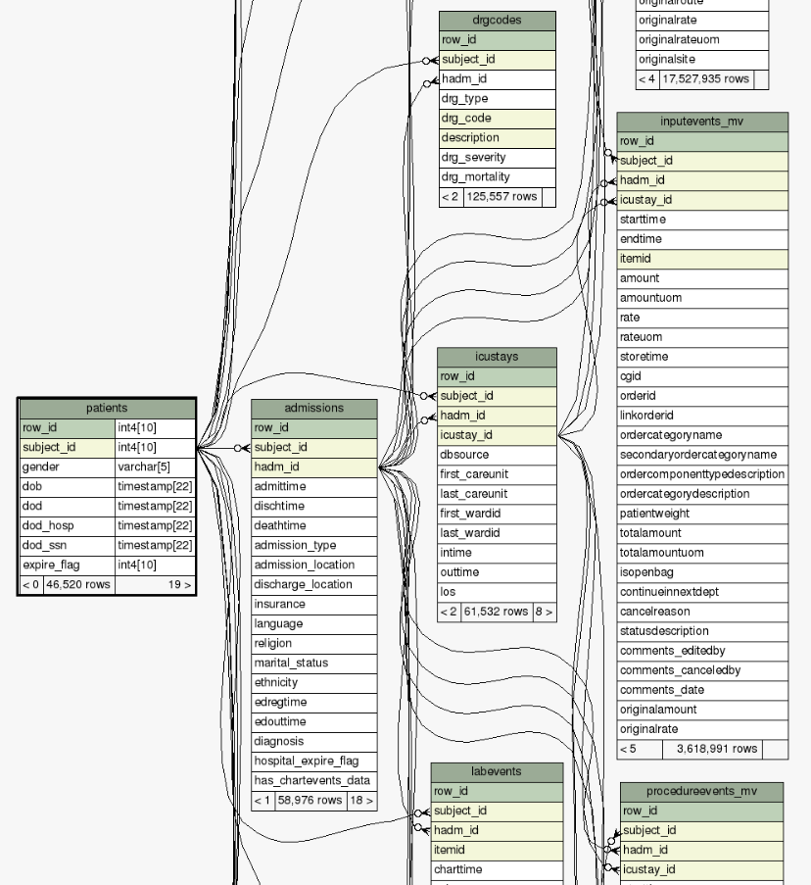
Getting Started with MIMIC-III Online Resource: Database Schema
https://mit-lcp.github.io/mimic-schema-spy/tables/patients.html

Slide 10
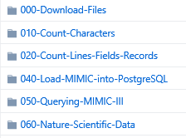
Getting Started with MIMIC-III Loading Postgres Database
https://mimic.physionet.org/gettingstarted/dbsetup/ https://github.com/EarlGlynn/MIMIC-III-Getting-Started
Quality Checks
count.fields
Loading databse
SQL / R dplyr examples Jupyter notebook example

Slide 11
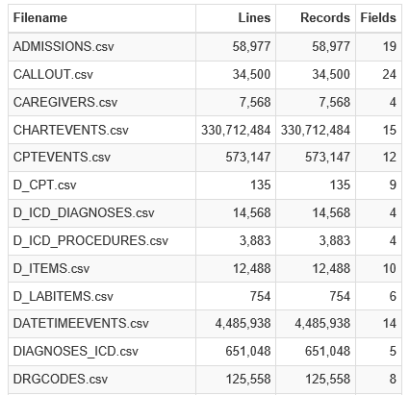

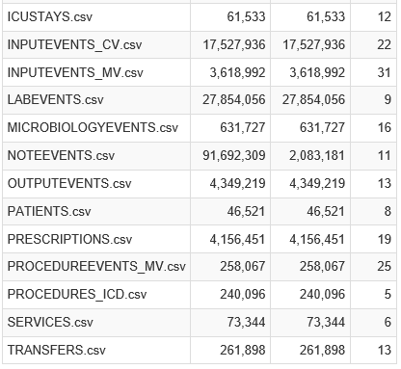
Getting Started with MIMIC-III Loading Postgres Database
020-Count-Lines-Fields-Records\MIMIC-III-Will-Files-Parse.nb.html
All counts include header records

Slide 12
Getting Started with MIMIC-III Loading Postgres Database
Use Natural Language Processing with NOTEEVENTS
… HISTORY OF PRESENT ILLNESS: This is an 81-year-old female
with a history of emphysema (not on home O2), who presents
with three days of shortness of breath thought by her primary
care doctor to be a COPD flare. Two days prior to admission,
she was started on a prednisone taper and one day prior to
admission she required oxygen at home in order to maintain
oxygen saturation greater than 90%. She has also been on
levofloxacin and nebulizers, and was not getting better, and
presented to the [**Hospital1 18**] Emergency Room.
In the [**Hospital3 **] Emergency Room, her oxygen saturation was
100% on CPAP. She was not able to be weaned off of this
despite nebulizer treatment and Solu-Medrol 125 mg IV x2.
…
020-Count-Lines-Fields-Records\MIMIC-III-Will-Files-Parse.nb.html

Slide 13
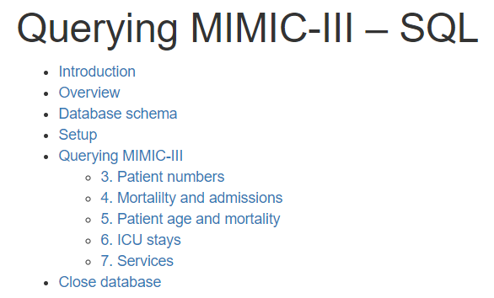
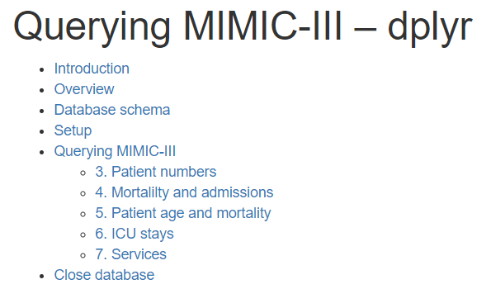
Getting Started with MIMIC-III Querying MIMIC-III with SQL or R dplyr
RStudio Notebooks
Example 3. Patient Numbers
Querying-MIMIC-III-SQL.html
Querying-MIMIC-III-dplyr.html
Reproduced SQL examples, and showed utility of dplyr tidyverse approach.
https://mimic.physionet.org/tutorials/intro-to-mimic-iii/
050-Querying-MIMIC-III/Querying-MIMIC-III-SQL.html
050-Querying-MIMIC-III/Querying-MIMIC-III-dplyr.html

Slide 14


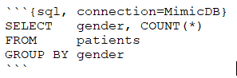
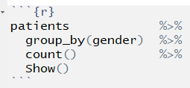
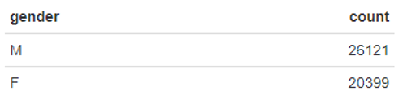
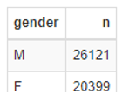
Getting Started with MIMIC-III Querying MIMIC-III with SQL or R dplyr
Example 3. Patient Numbers
RStudio Notebooks
Querying-MIMIC-III-SQL.html
Querying-MIMIC-III-dplyr.html
SQL Chunk
R Chunk
magrittr “forward pipe” operators.
Read as “then”
050-Querying-MIMIC-III/Querying-MIMIC-III-SQL.html
050-Querying-MIMIC-III/Querying-MIMIC-III-dplyr.html

Slide 15
Notes
Tidy Data https://vita.had.co.nz/papers/tidy-data.pdf
Tidyverse https://rviews.rstudio.com/2017/06/08/what-is-the-tidyverse/
R Markdown for Medicine https://rmd4medicine.netlify.com/

Slide 16

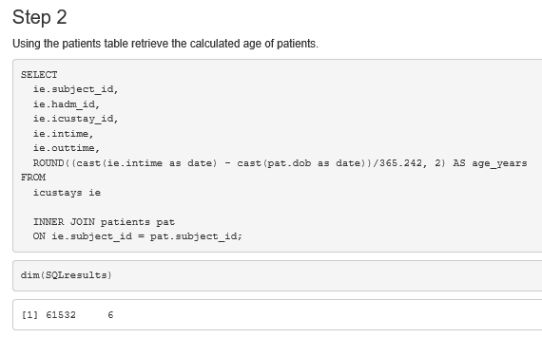

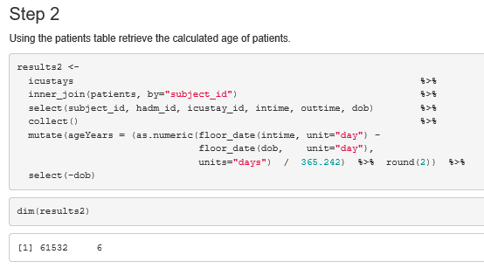
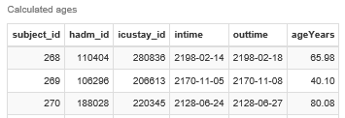
Getting Started with MIMIC-III Querying MIMIC-III with SQL or R dplyr
Tutorial. Step 2
SQL
dplyr
DB
R
dbplyr uses “lazy evaluation.” collect forces
computation of database query.
https://mimic.physionet.org/tutorials/intro-to-mimic-iii/
050-Querying-MIMIC-III/Querying-MIMIC-III-Tutorial-Problem-SQL.html
050-Querying-MIMIC-III/Querying-MIMIC-III-Tutorial-Problem-Tidyverse-dplyr.html

Slide 17
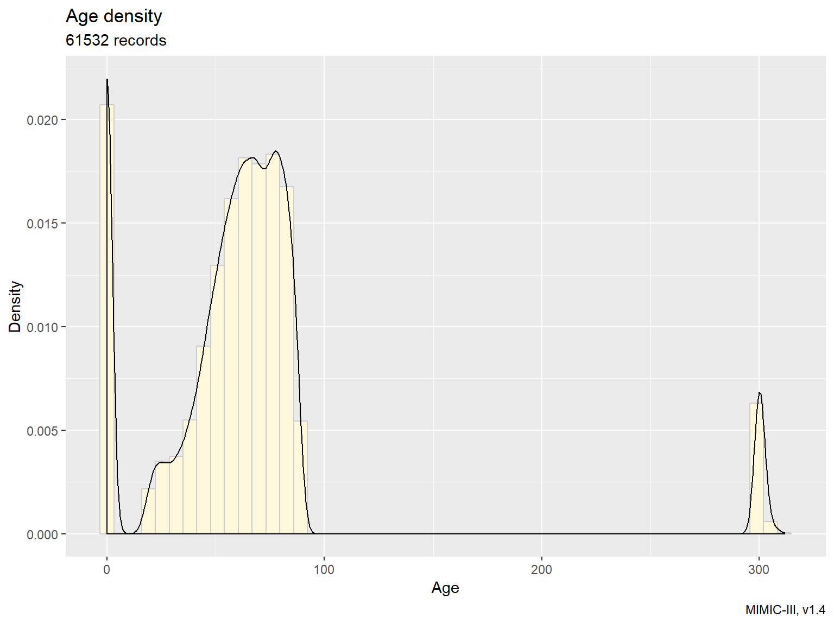
Getting Started with MIMIC-III Querying MIMIC-III with SQL or R dplyr
Tutorial. Step 2
050-Querying-MIMIC-III/Querying-MIMIC-III-Tutorial-Problem-SQL.html
050-Querying-MIMIC-III/Querying-MIMIC-III-Tutorial-Problem-Tidyverse-dplyr.html

Slide 18
MIMIC-III Explorations
Patients Table
Diagnoses Tables
LabEvents Table
https://github.com/EarlGlynn/MIMIC-III-Exploration

Slide 19
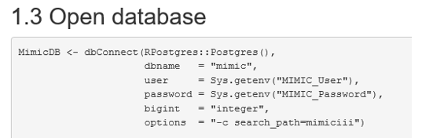
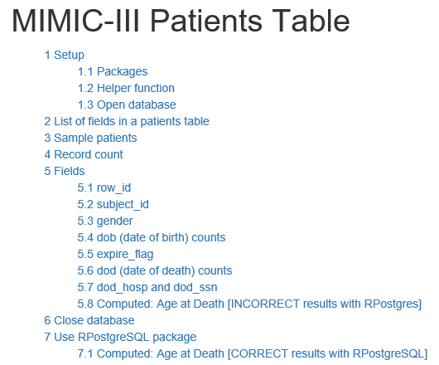
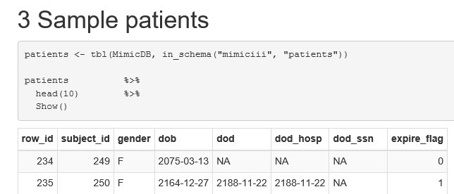
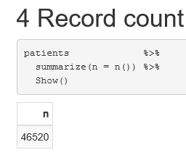
MIMIC-III Explorations Patients Table
RStudio Notebook
Create your own detailed data dictionary.
patients/Patients.html

Slide 20
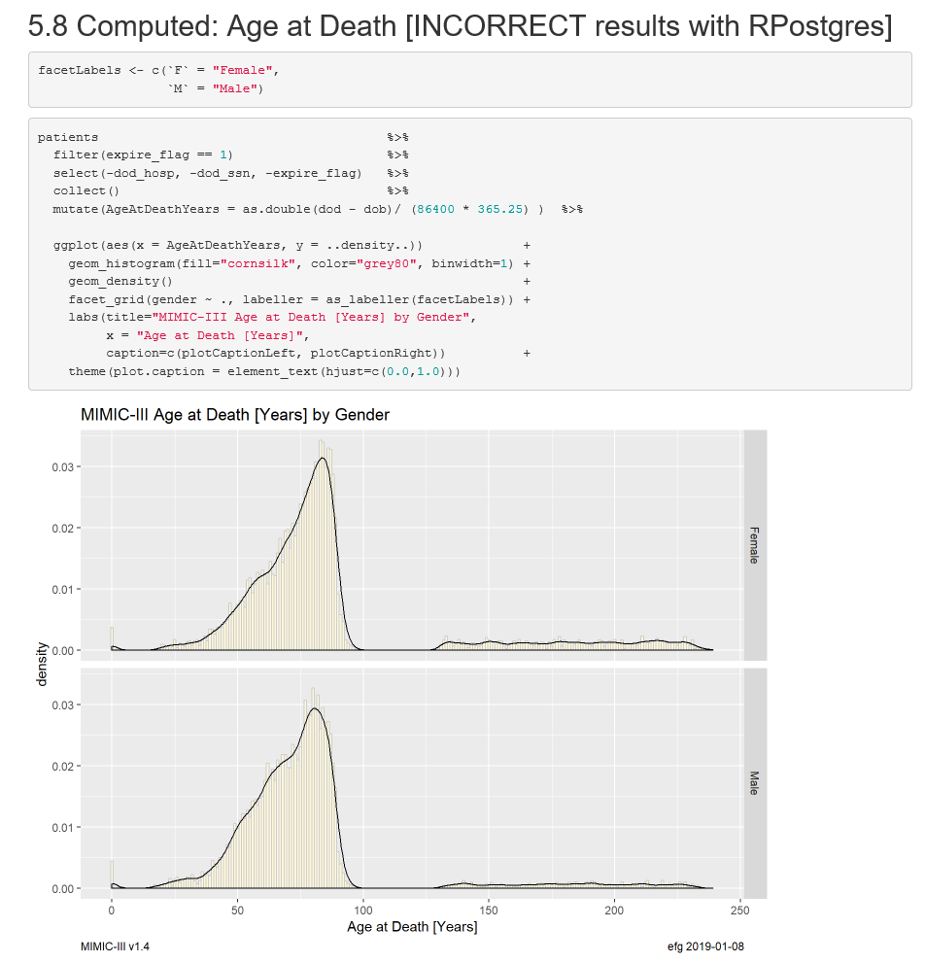

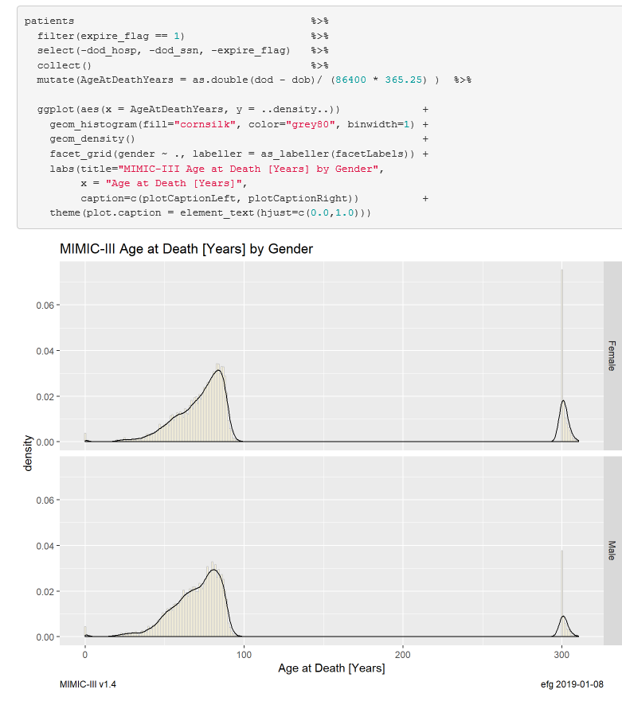

MIMIC-III Explorations Patients Table
patients/Patients.html

Slide 21
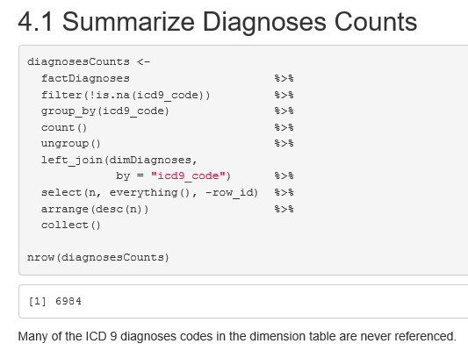
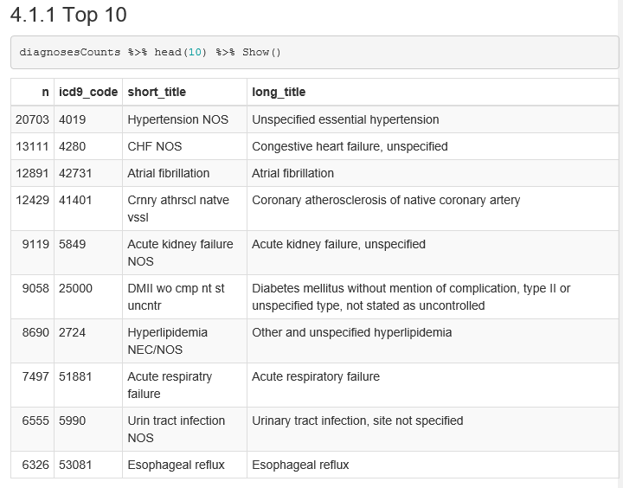
MIMIC-III Explorations Summarize Diagnoses Counts: Top 10
diagnoses_icd/Diagnoses.html

Slide 22
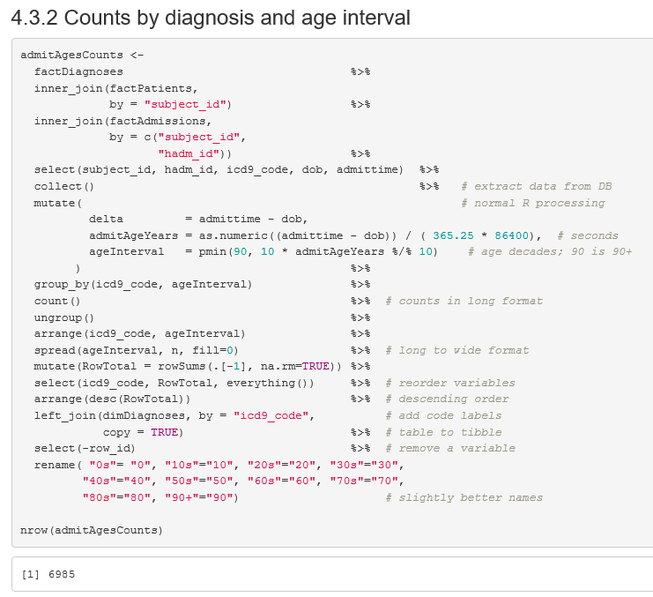
MIMIC-III Explorations Summarize Diagnoses by Age Intervals
diagnoses_icd/Diagnoses.html

Slide 23
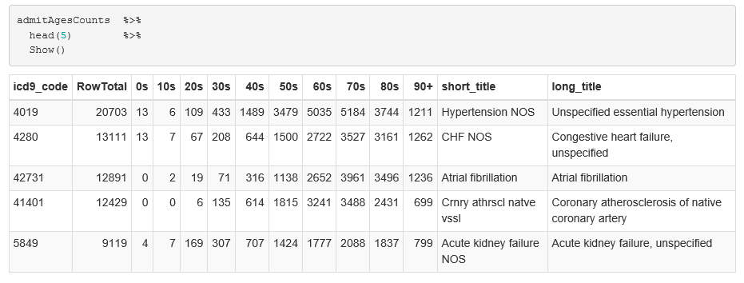
MIMIC-III Explorations Summarize Diagnoses by Age Intervals
Can be a “shopping” list to identify research cohorts.
diagnoses_icd/Diagnoses.html MIMIC-III-Diagnoses-Counts-by-Age-Intervals-Edited.xlsx

Slide 24
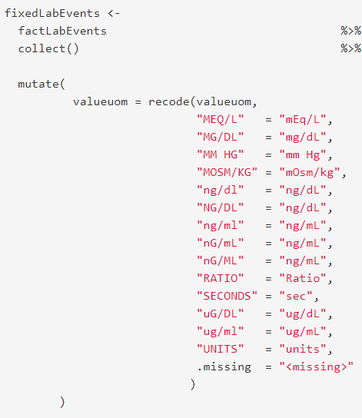
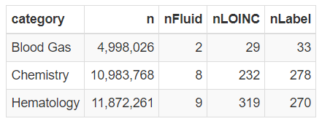
MIMIC-III Explorations Labevents
27,854,055 lab values
3,100,249 with missing units
1,002,385 missing LOINC; some duplicate LOINCs
Needs cleanup for consistency
3 categories
Used
“majority vote”
to resolve
case differences
labevents/ labevents-FirstLook.html labevents.html

Slide 25
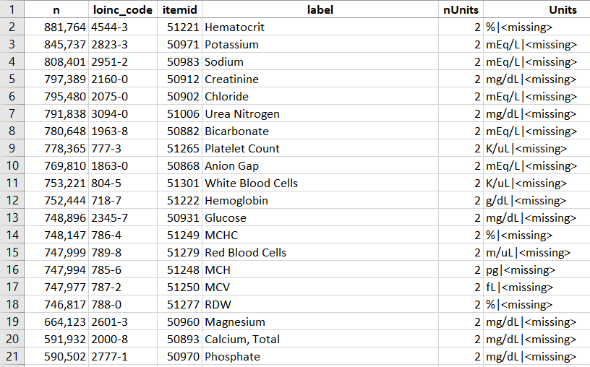

MIMIC-III Explorations Labevents
Top 20
. . .
labevents/ labevents.html, Section 3.7.1 Lab-Event-Item-Counts.xlsx

Slide 26
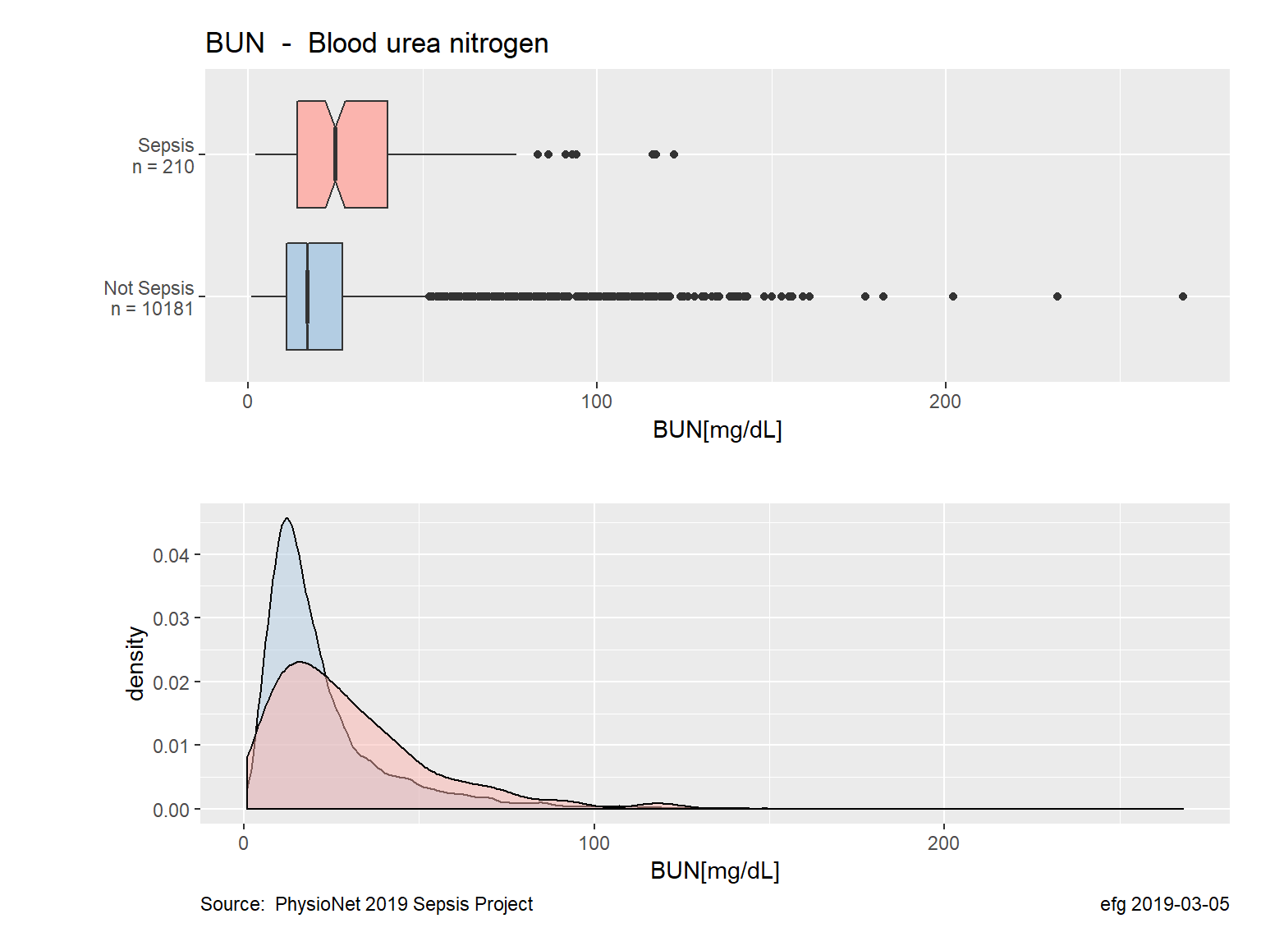
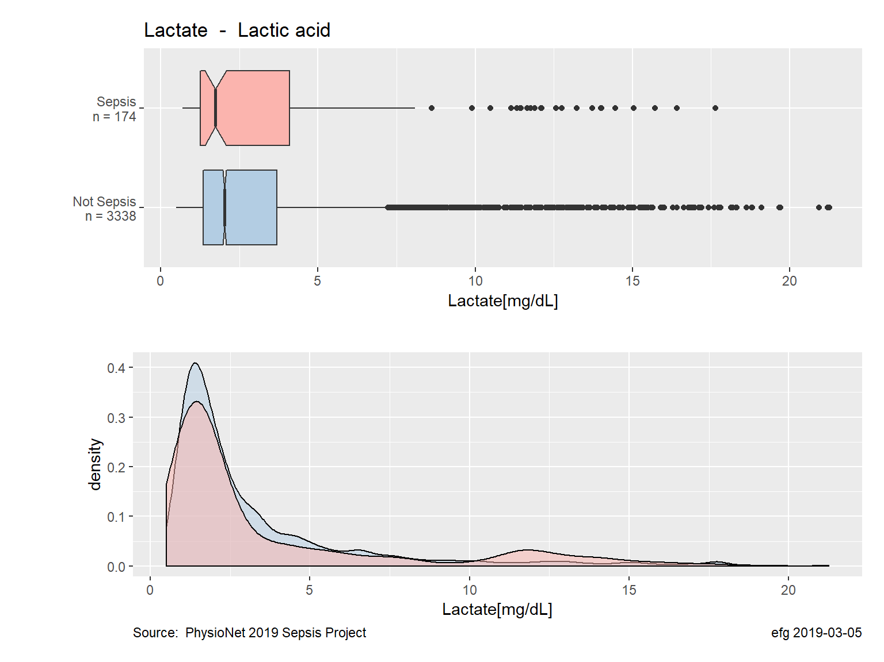
MIMIC-III Explorations Labevents
labevents https://github.com/EarlGlynn/PhysioNet-Sepsis-Challenge 030-Descriptive-Stats/LaboratoryValues-Stats.html

Slide 27
Outline
What is MIMIC-III?
MIMIC-III: Research and Education
Getting Started with MIMIC-III
MIMIC-III Explorations
Machine Learning Using MIMIC-III
Other PhysioNet Resources
Take Home

Slide 28

Machine Learning with MIMIC-III
https://www.ncbi.nlm.nih.gov/pubmed/31209213, June 2019 Code: https://zenodo.org/record/1306527#.XYgY-yhKjYY

Slide 29
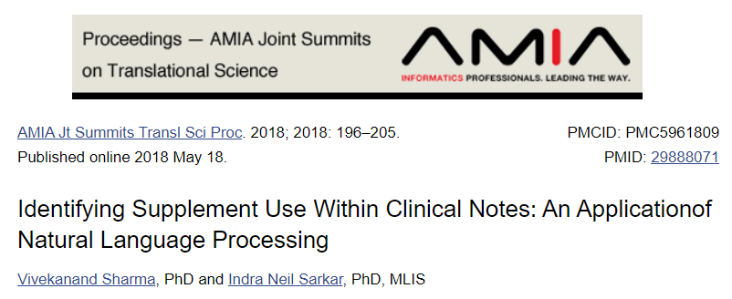
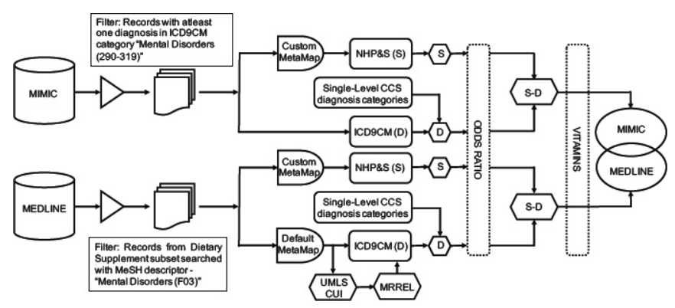
Machine Learning with MIMIC-III
This study explored the feasibility to uncover patterns in the use of supplements,
focusing on vitamin use among patients diagnosed with mental illness
within patient records from the MIMIC-III database..
https://www.ncbi.nlm.nih.gov/pmc/articles/PMC5961809/, May 2018

Slide 30
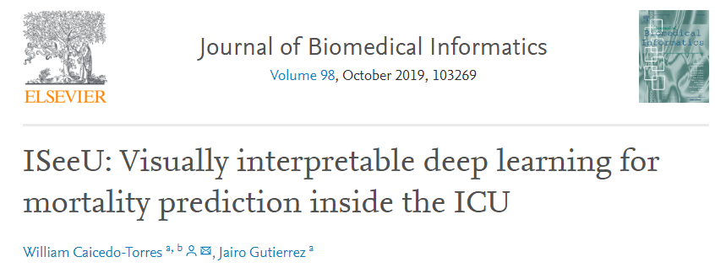
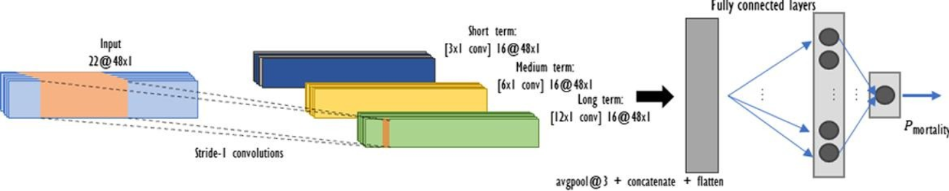
Machine Learning with MIMIC-III
https://www.ncbi.nlm.nih.gov/pubmed/31430550 August 2019

Slide 31
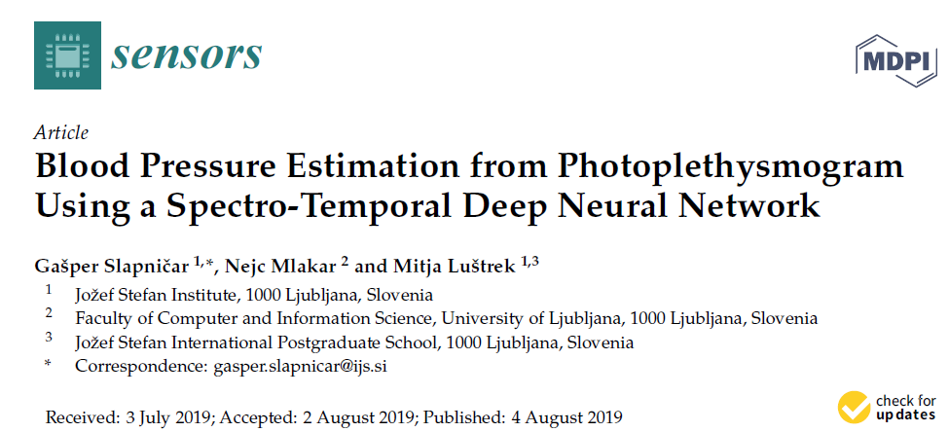
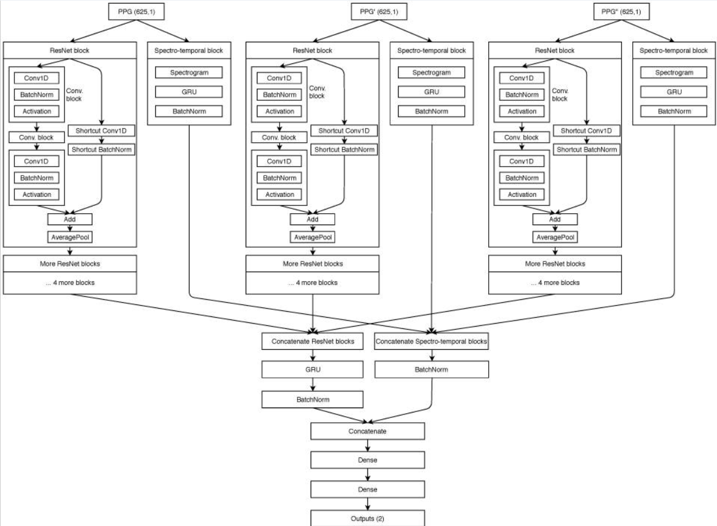
Machine Learning with MIMIC-III
We analyzed the MIMIC III database for high-quality PPG and arterial BP waveforms, resulting in over 700 h of signals after preprocessing, belonging to 510 subjects.
https://www.ncbi.nlm.nih.gov/pubmed/31382703, August 2019

Slide 32

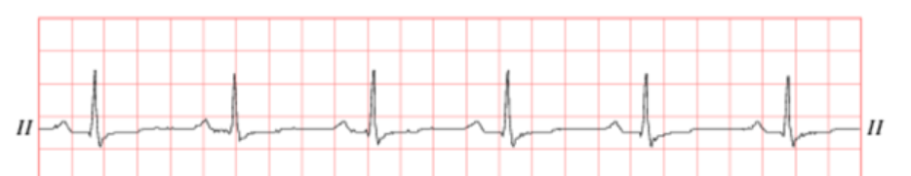
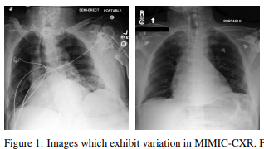
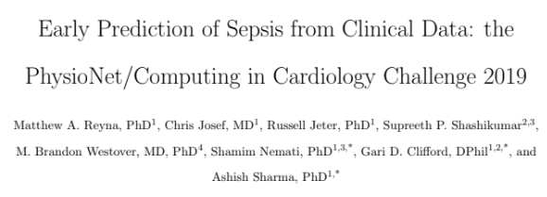
Other PhysioNet Resources
https://physionet.org/
MIMIC-III Waveform Database https://archive.physionet.org/physiobank/database/mimic3wdb/
MIMIC Chest X-Ray Database https://physionet.org/content/mimic-cxr/2.0.0/
2019 PhysioNet Challenge Slides/Posters Reyna MA, Josef C, Jeter R, Shashikumar SP, M. Brandon Westover MB, Nemati S, Clifford GD, Sharma A. Early prediction of sepsis from clinical data: the PhysioNet/Computing in Cardiology Challenge 2019. Critical Care Medicine, in press.

Slide 33
Take Home
MIMIC-III is a great EHR data source for research projects and data science experiments, including predictive analytics projects.
Will MIMIC-III be updated in 2019?

Slide 34


